Slide 1
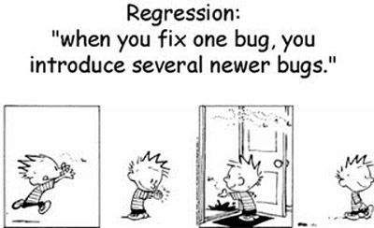
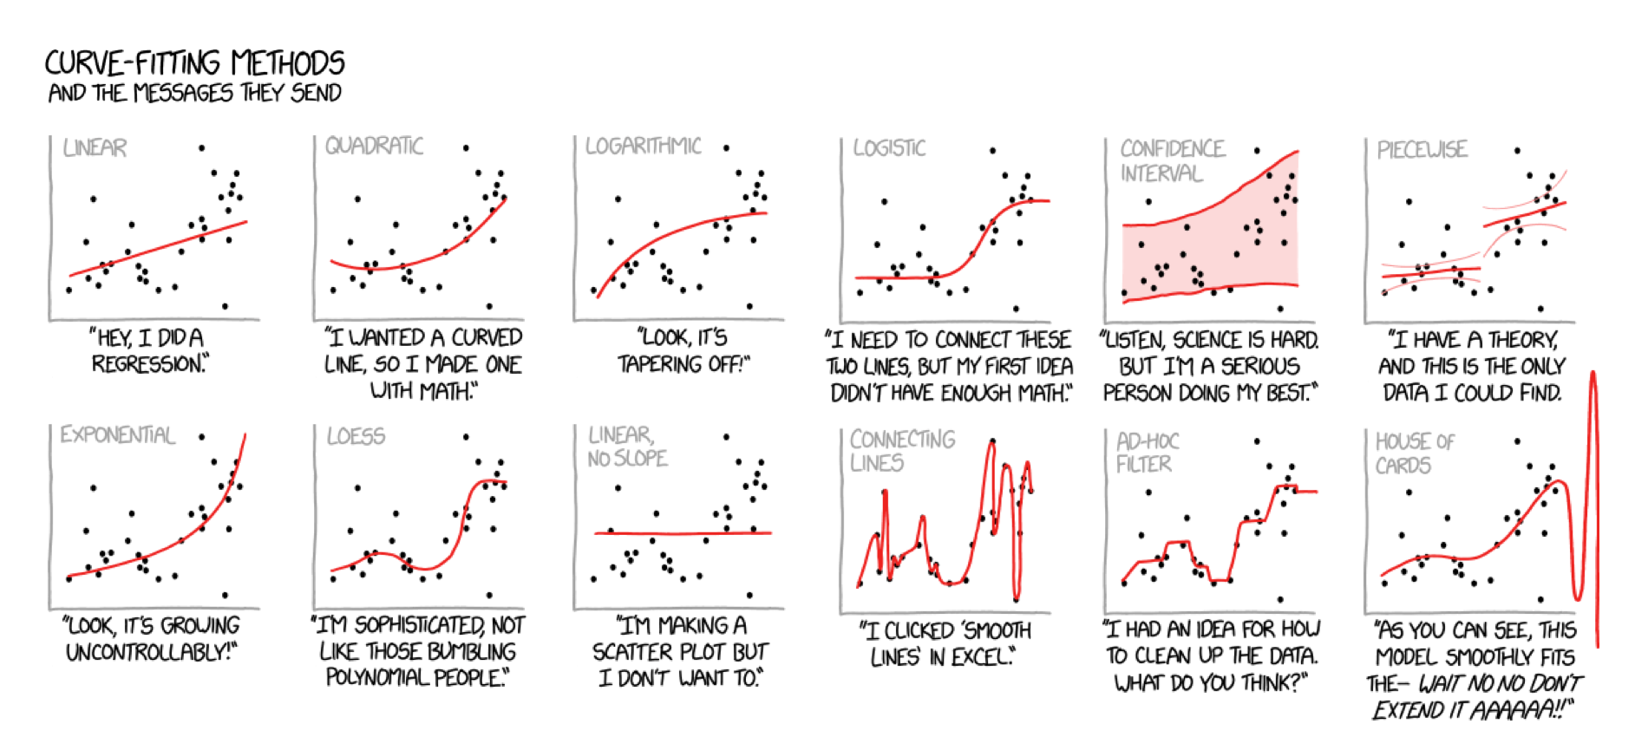

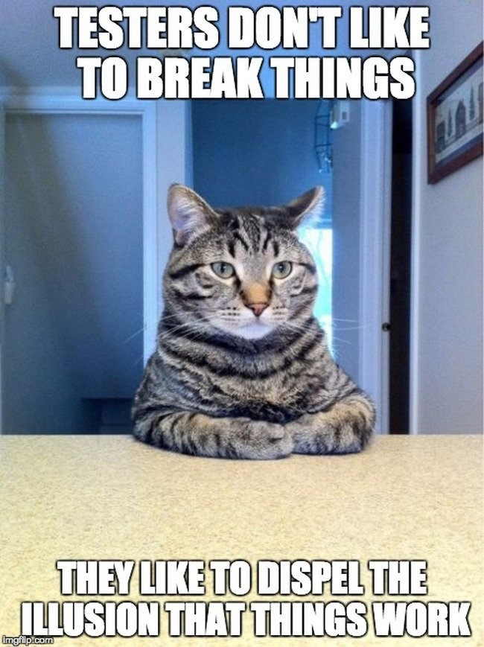
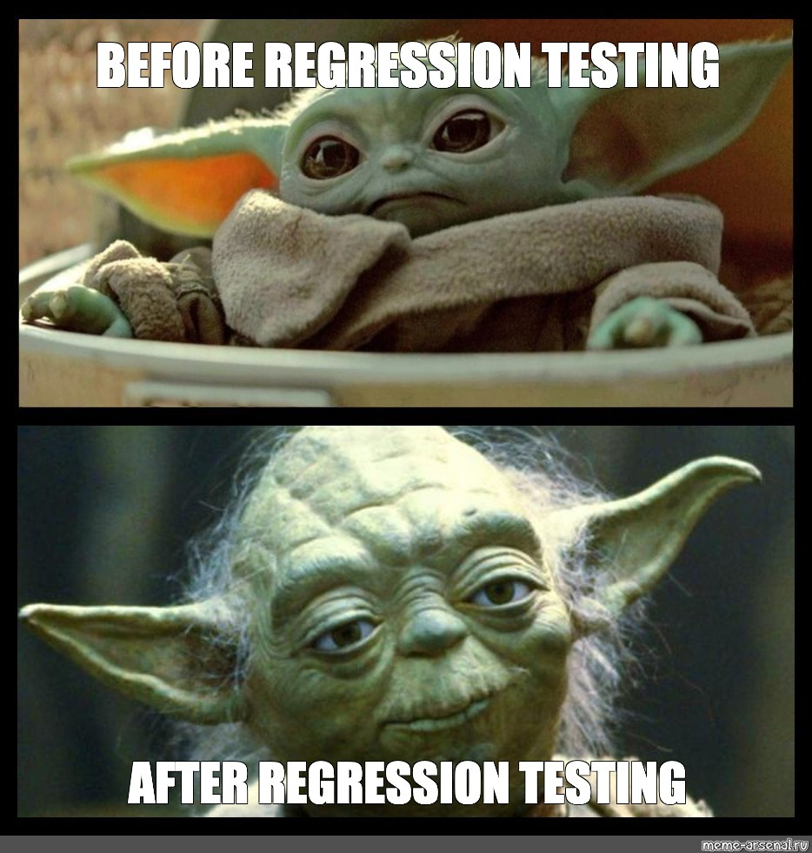

CSE 270 Week 08
X
Not this type of regression actually kind of
Regression Testing

Slide 2
Class Agenda
Monday
Assignment Overview
Discussion on Regression Testing
Overview of Regression Testing Techniques
Find a Code base
Wednesday
Work on creating regression test code base
Friday
Work on

Slide 3
Weekly Agenda
Reading: Read about regression testing.
Identify a Codebase: With your partner(s), identify a codebase suitable for this week's lab.
Create a Regression Test Plan: Create a plan for performing regression testing on your codebase of choice.
Conduct a Regression Test: Carry out your regression test plan and report on the results.

Slide 4
Reading
Ron Patton's Software Testing, Second Edition:
Software Testing, Second Edition by Ron Patton, Published by Sams, 2005
Chapter 3: The Realities of Software Testing

Slide 5
What is Regression Testing?
What you should be able to answer by the end of the week….
Which testing techniques are used for Regression Testing (See Module 4)?
What is happy path testing?
Is it just the non-error path?
Is it possible to create enough tests to cover all code created?
There are several strategies in writing code to ensure complete code coverage. Research and provide a summary of your findings.
What are the risks?
How do you migrate a manual test into an automated test?

Slide 6
Class Discussion
Is there such thing as a perfect program?
Is there such thing as perfect code?
Can you test the entire program?
Does S/W programs change?
Does code change?
Does a program get old?
Does code get old?

Slide 7
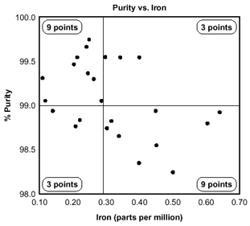
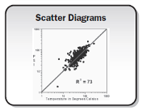
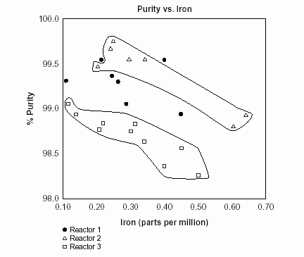
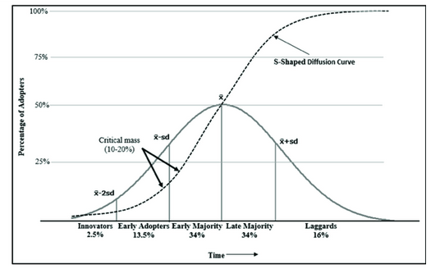
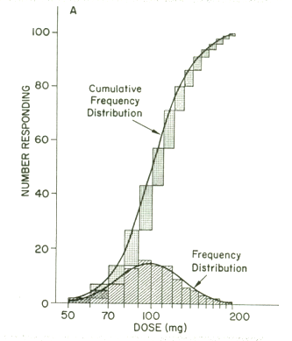
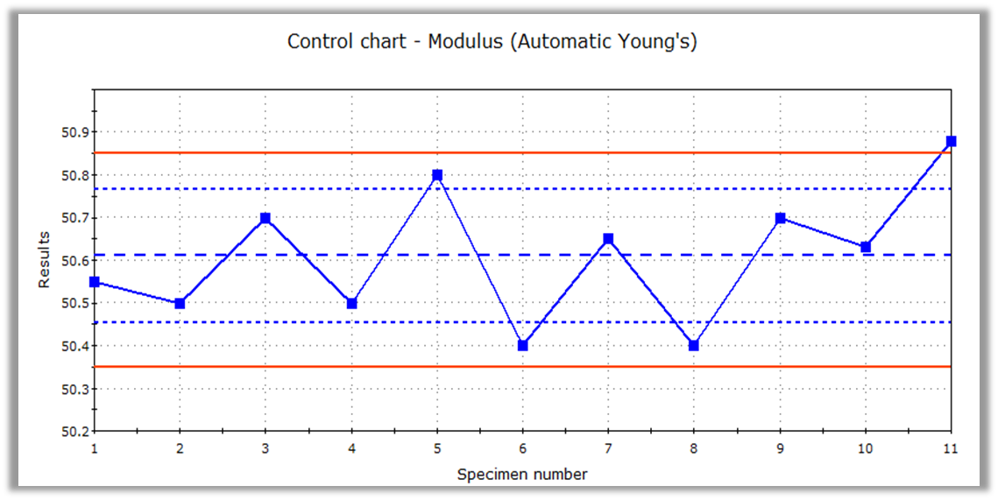
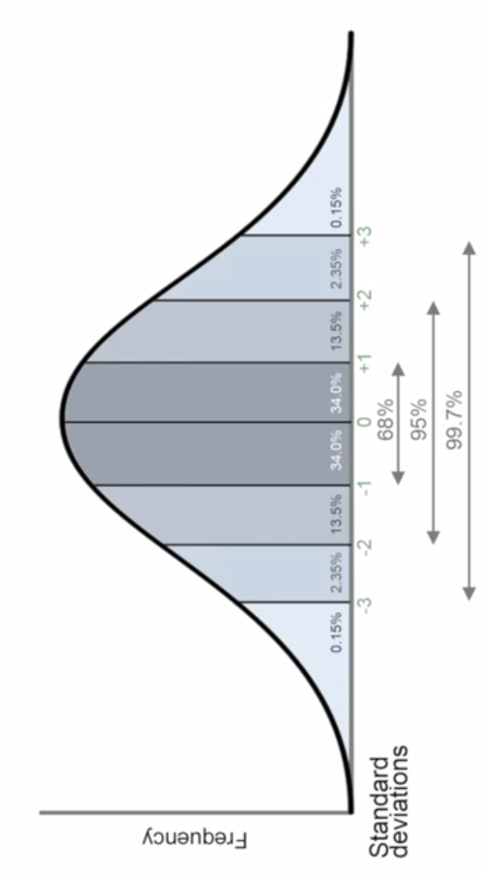

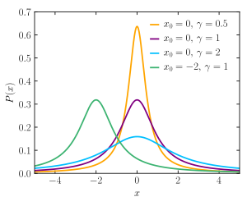
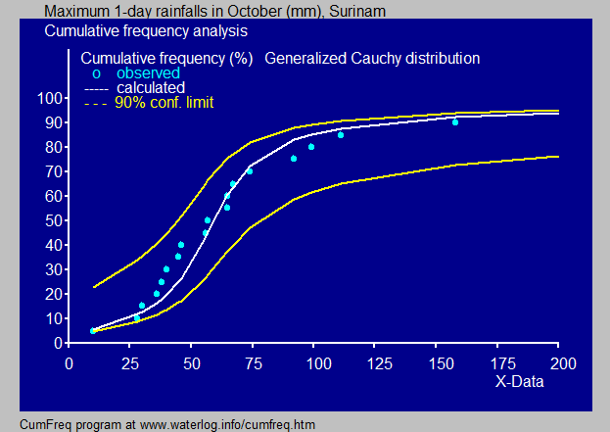
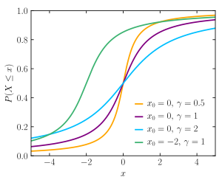
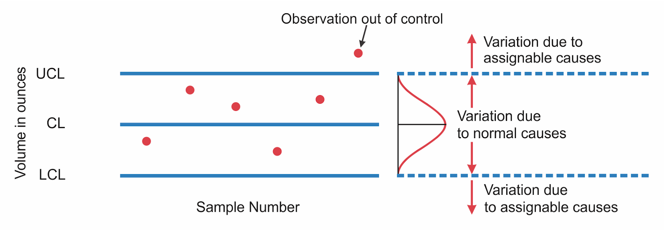
Happy Path Testing
Known path Testing
Expected Path Testing

Slide 9
Overview
Teach
Prove
Identify Code Base
Identify a feature & change in code
Write regression plan with tests
Get copy of code before change
Execute plan
Record results
Write test report
Get copy of code after change
Execute plan again
Record results

Slide 10
Assignment: Regression Testing Plan
Identify a Codebase: With your partner(s), identify a codebase suitable for this week's lab
With your partner(s), identify a code change that can be made in the code-base previously selected.
This change should not alter the functionality of the project, but rather modify an implementation detail. In other words, the functionality of the code should not change.
Examples
Encapsulate: Take a data structure that was created with built-in data types and turn it into a class. For example, turn a Sudoku board created from a 9x9 array of integers into a Board class.
File Format: Adjust the file format from one format to another. For example, consider a Sudoku file format that consisted of 81 numbers. Turn this file format into JSON.
Algorithm. Oftentimes, more than one algorithm produces the same result. When this is the case, swap out one algorithm for another. For example, swap a bubble sort for an insertion sort, or a linear search for a binary search.

Slide 11
Examples of Code Bases (Open Source)
Tiddlywiki
https://github.com/Jermolene/TiddlyWiki5
https://github.com/TiddlyWiki/TiddlyWiki
Canvancements
https://github.com/jamesjonesmath/canvancement
Church related projects
Games:
Chess, Yahtzee, Catan
Editors

Slide 12

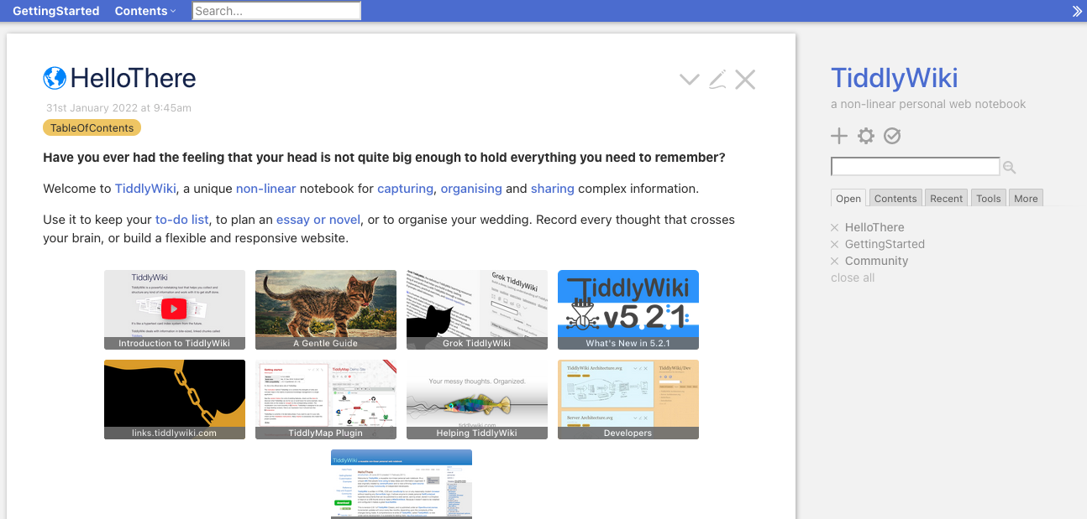
Example: TiddlyWiki (https://tiddlywiki.com/)
What is a tiddlewiki?
Welcome to TiddlyWiki, a unique non-linear notebook for capturing, organising and sharing complex information.
A tiddlywiki is a one-page wiki. It is a self-writable webpage, that you can add content dynamically.
Tiddlywiki is a collection of Tiddlers
Tiddler are linked together by tags
Tiddlers can be macros & plugins
You can import and export tiddlers
And powered by node.js engine kernel in the webpage

Slide 13
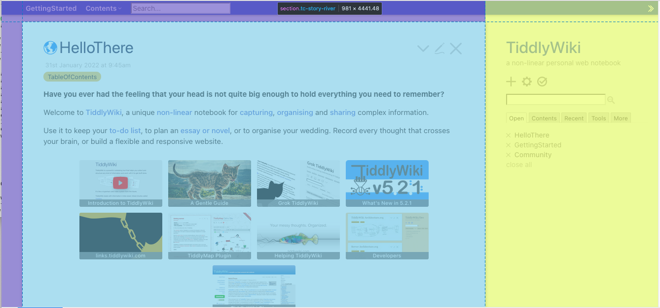
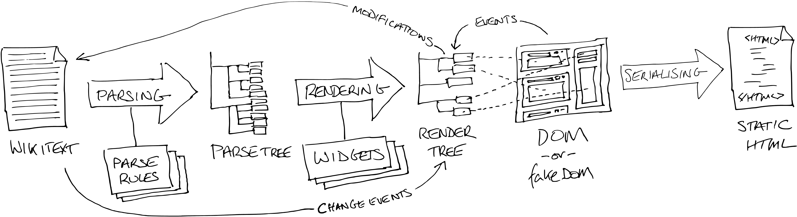
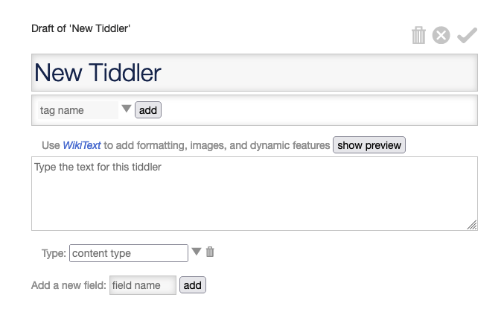
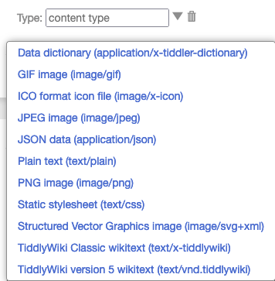
Tiddlywiki
tc-body
Browser Page
Tiddlywiki
webpage architecture
Html
div
dropzone
head
div
tc-page-container
tc-page-container
body
div
styleArea
div
tc-dropzone
tc-alert
noscript
tc-story-river
tc-sidebar
div
storageArea
tc-dropzone
div
libraryModule
div
tc-sidebar
Difference between what is stored and what is rendered
div
bootKernalPrefix
section
tc-story-river
div
bootKernal
div
tc-alerts
div
tc-password
tc-story-river
tc-story-river
section
story-backdrop
tc-tiddler-frame*
div
tc-tidder-frame
section
Story-frontdrop
tc-tiddler-frame
tc-tidder-frame
tc-tiddler-title
div
tc-tiddler-title
div
tc-reveal (hidden)
tc-tiddler-reveal (hidden)
div
tc-reveal (subtitle)
div
tc-reveal(tag-list
tc-tiddler-reveal(subtitle)
div
tc-tiddler-body
tc-tiddler-reveal (tag-list)
Html
tc-tidder-frame
tc-tiddler-body
div
tc-table-of-contents
Html
ol
tc-toc toc-selective-expandable
li
toc-item*
a
tc-tiddlylink
tc-table-of-contents
span
tc-reveal
button
tc-btn-invisible
>\/
Item*
svg
tc-image-right-arrow
Html tag
Html - item
class=“name”
/a
toc-selective-expandable 'Settings'

Slide 14
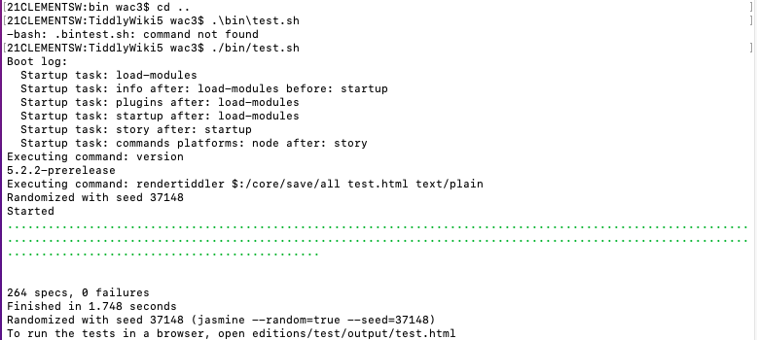

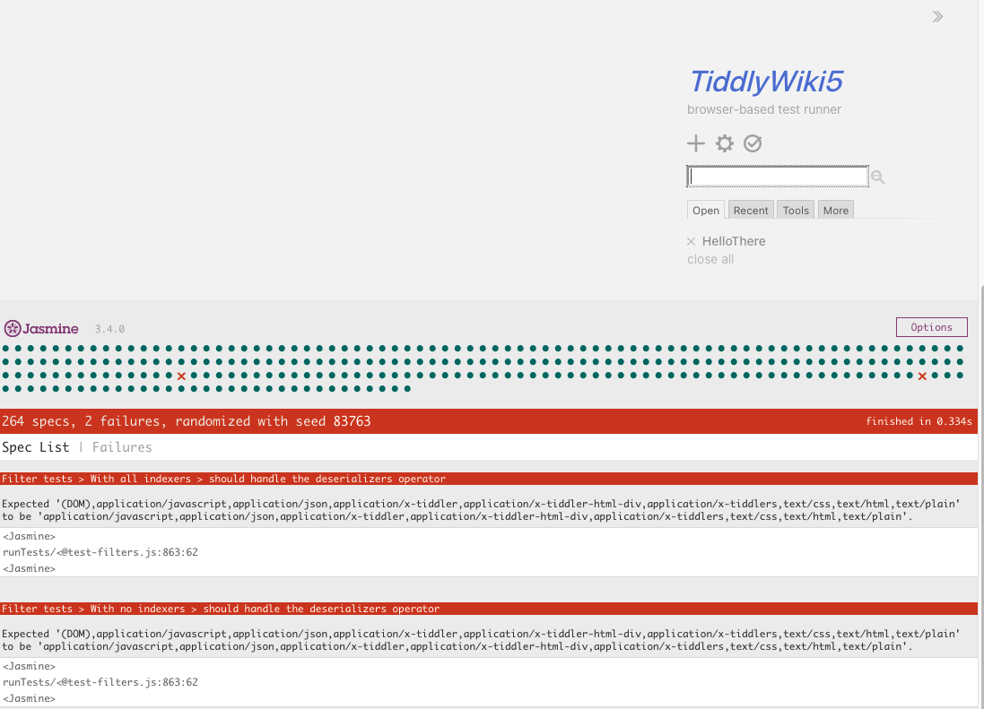

Example: TiddlyWiki (https://tiddlywiki.com/)
What is a tiddlewiki? A tiddlywiki is a one-page wiki. It is a self-writable webpage, that you can add content dynamically.
Location: https://github.com/Jermolene/TiddlyWiki5
Has a regression test
/bin/test.sh (mac/unix) or /bin/test.cmd (win)
Need node.js to run
Results are found: /editions/test/output/test.html
Pick a tiddler, in a tiddlywiki. Write requirements for it to start the process of writing your test plan.

Slide 15
Assignment: Regression Testing Plan
Now that you have identified the code change that you are going to make, create a plan for how you will validate that the change did not impact functionality.
To do this, you are going to generate an "appropriate" number of test cases to fully cover the change.
Exactly how many test cases will be required?
This depends on the complexity of your change. For example, if your code change was in how a tic-tac-toe board is stored in memory, then you will have to verify the file-save code, the display code, and the board edit code. Each of these three points will probably require a half dozen test cases.
Each test cases should be comparable in detail to what we produced last week.
Test plan outline
Purpose: What feature/quality is this testing?
List of Requirements: Uniquely id requirements
(You will need to come up with like last week)
List of Test Cases
Mapping of Requirements to Test Cases
Test Cases
Title/ID:
Purpose:
Requirements:
Pre-conditions:
Steps:
Action/Results
Action/Verify
Tear-down

Slide 16
Overview
Teach
Prove
Id Code Base
Id change in code
Write regression plan with tests
Get copy of code before change
Execute plan
Record results
Write test report
Get copy of code after change
Execute plan again
Record results

Slide 17
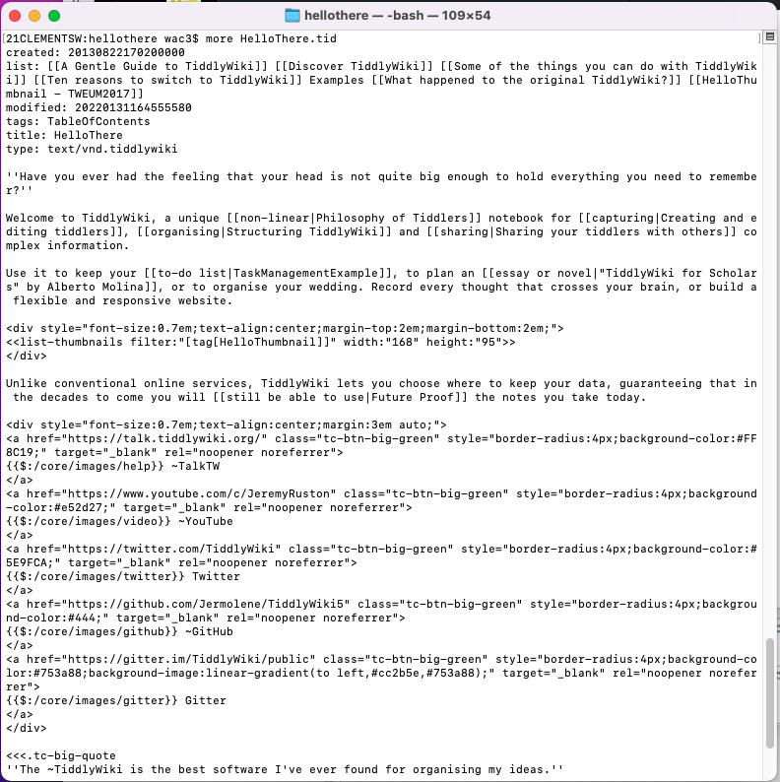
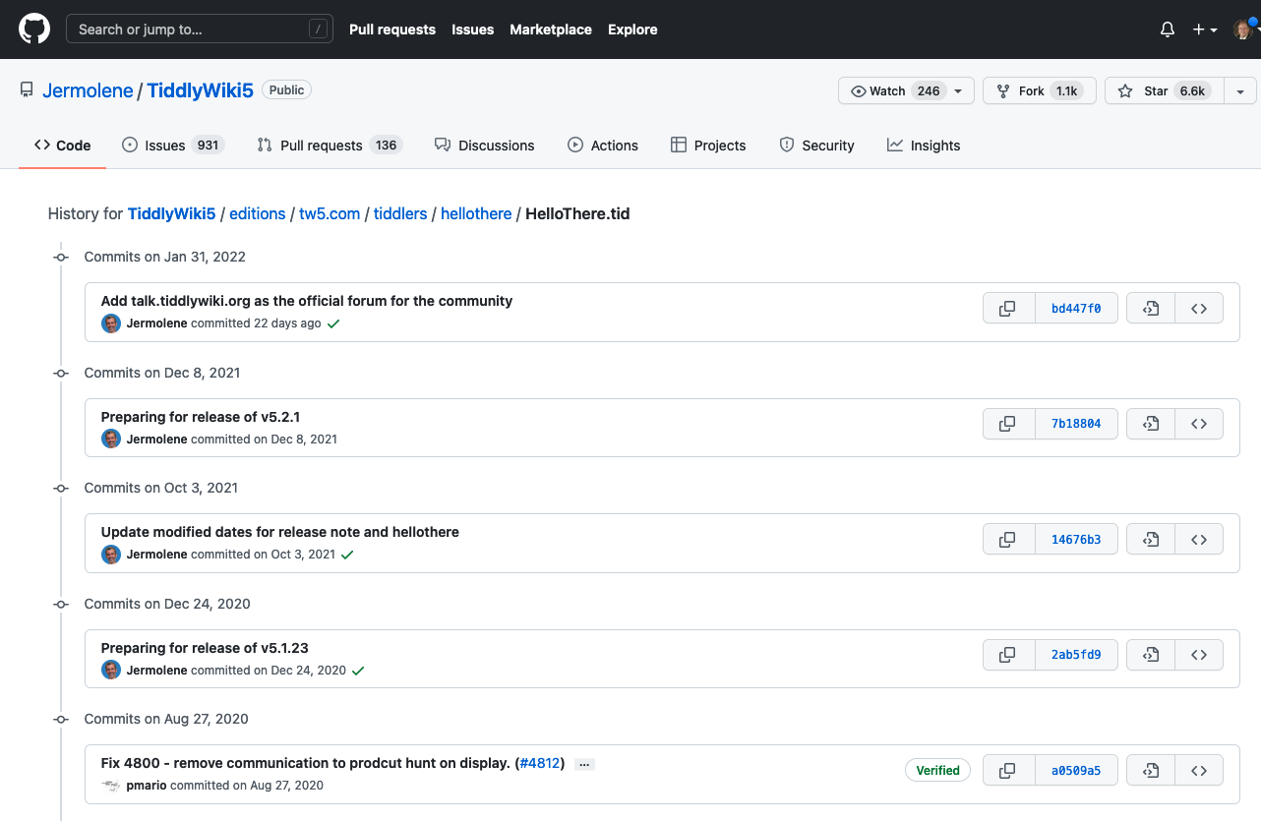

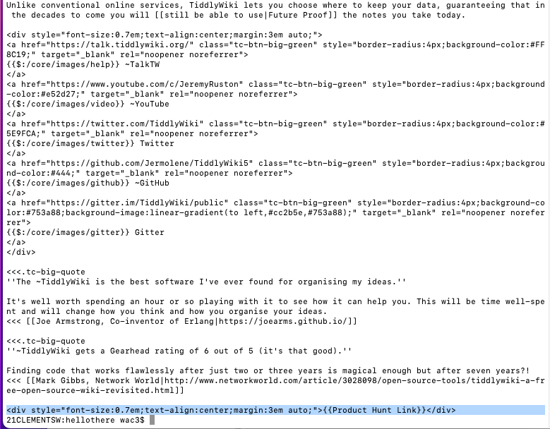
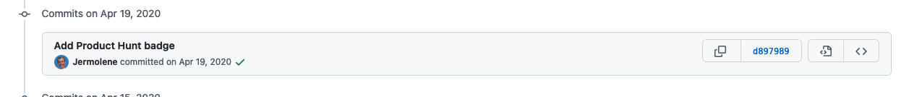
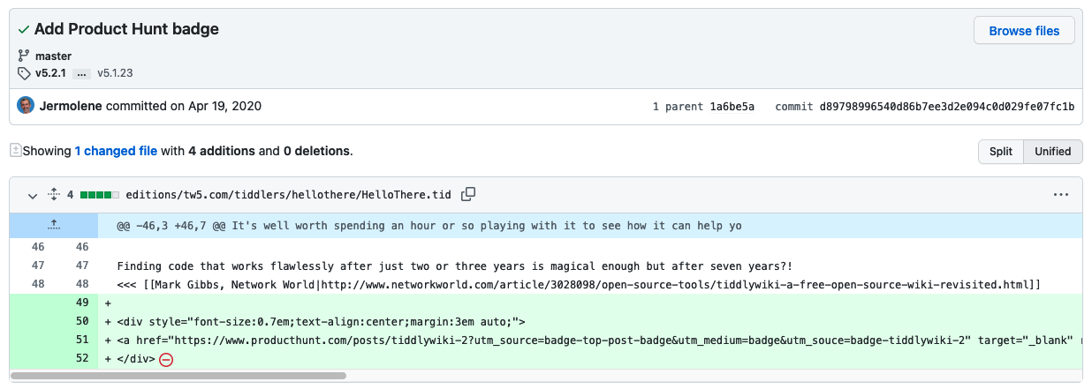
Example of finding a tiddler change

Slide 18
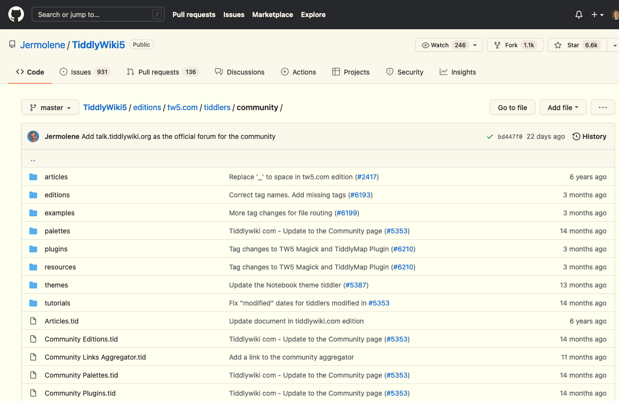
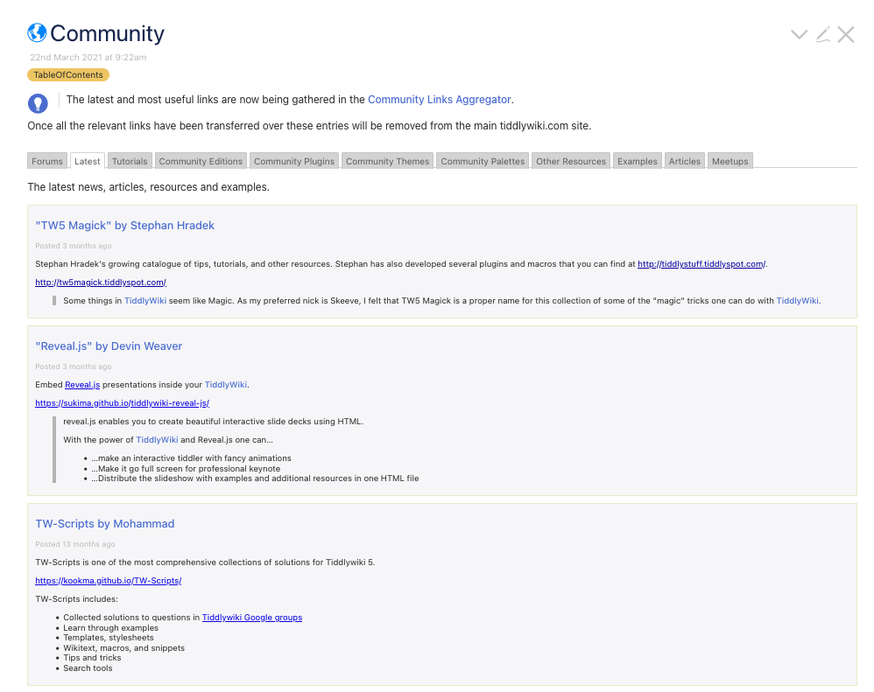
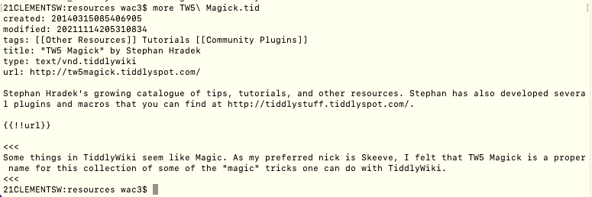
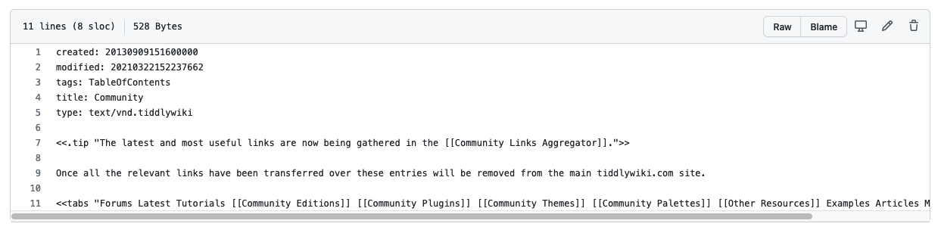
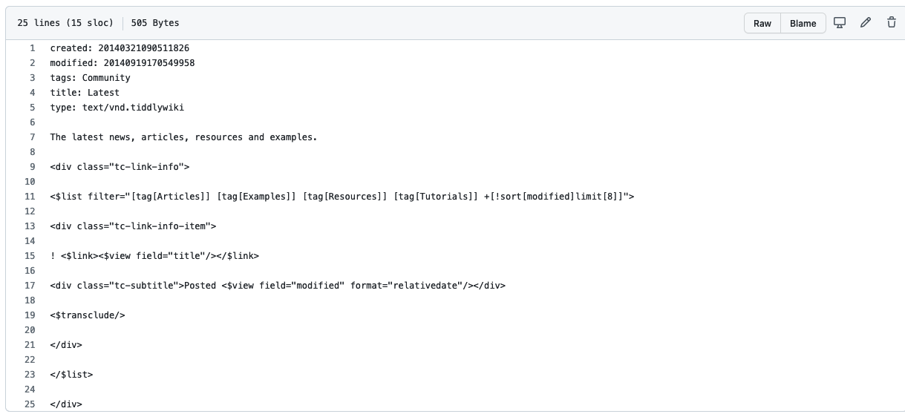
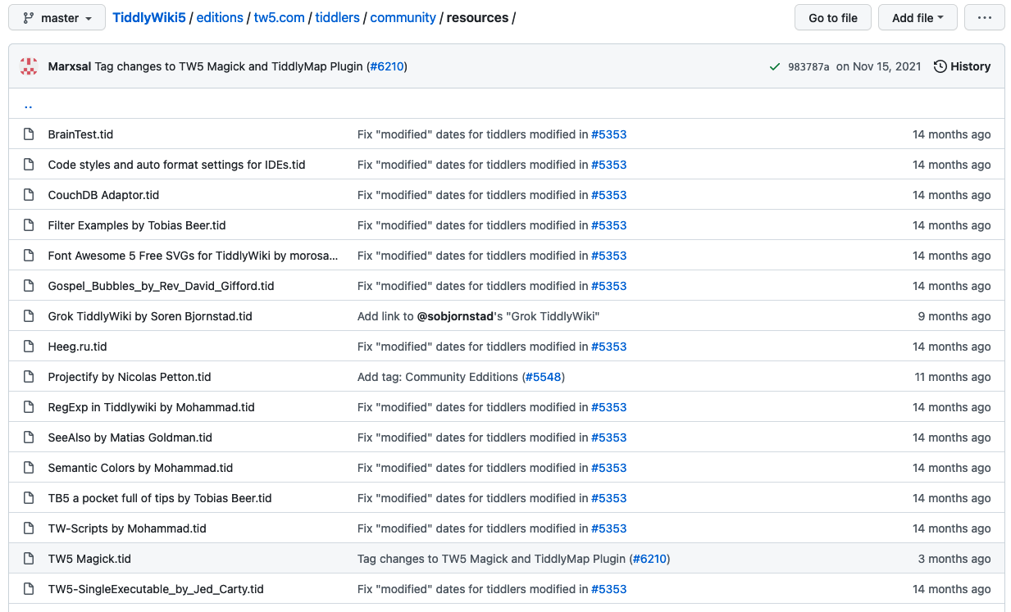
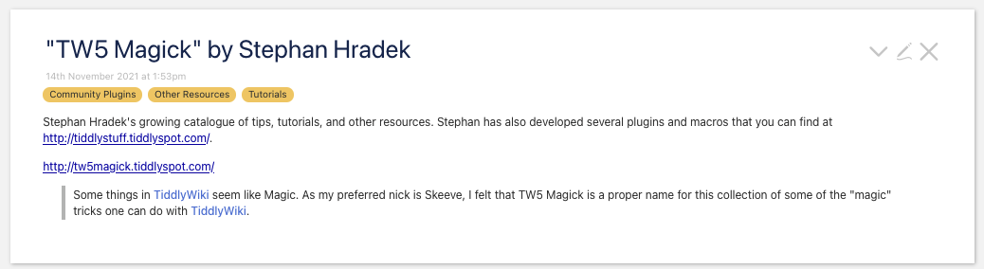
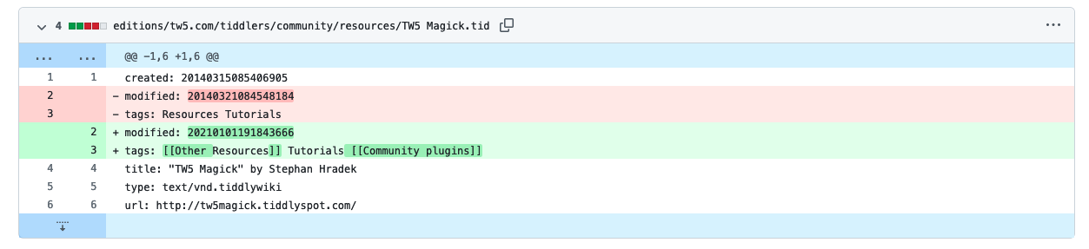
3
Another Example of finding a tiddler change
1
Four things that we are looking at:
Tiddlywiki: Community tiddler rendered in webpage
Tiddlywiki: Community tiddler code
Github location of Community tiddler
Github Community tiddler history change
Github TW5 Magick tiddler file
The tidder then lists a series of tiddlers based on tag/label.
5
2
The community page has tabs that are categorized by another tiddler
2
4
1
Tiddlywiki com - Update to the Community page (#5353)

Slide 19
Assignment: Regression Testing Plan
Write regression plan with tests
Submission
Your team will submit a single document for your test cases. The document needs to be in the PDF format. It must consist of the following components:
Project:
Provide a two or three sentence description of the project in which the code change will be made.
Code Change:
Describe in detail the code that will be changed. This includes the actual code that will be change (just the fragment that will require a change, not the entire program), and a description of what the code will look like after the change.
Test Cases: All the test cases that will be used to verify the change.
Checklist
Did your plan contain a purpose?
Did your plan have requirements?
Did you mention how the requirements map to the tests.
Does your plan have multiple tests cases?
Each test case use the format from last week?
ID/Title, Purpose, Steps (A/R, A/V), Conclusion

Slide 20
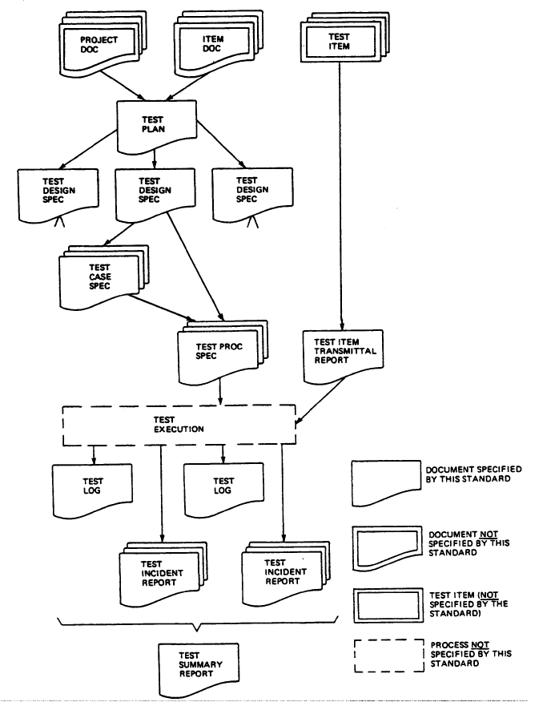
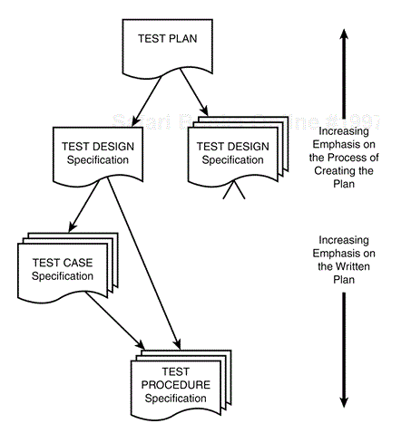
Writing a Test Plan
Throughout the semester you have been working on different aspect of the Test plan, this assignment you will be putting it all together.
Notes:
Software Testing, Second Edition by Ron Patton Published by Sams, 2005

Slide 21
Test Plan
Title Page
Test Team name
Project Name
Signature block: with authors names and date
Section 1: Introduction of Project
Provide a description of the project. And the purpose of the Plan
Section 2: Requirement
Create verification requirements based on the workflow from Week 08 Lab.
Create 5 or more requirements from the following summary of the requirements:
User can login into Dr. Mobile, go to the Home Page, add a new Patient, Diagnosis the Patient and Monitor the Patient.
User can order new supplies.
Number each requirement..
Section 3: Quality Model
Identify at least 5 Quality Characteristics.
Use your Prove 5 Quality Models to list the qualities that you identified as part of the system.
For each Quality Characteristic identify at what level (Unit, Regression, Integration) should the test cases be completed.
Section 4: Test Cases
List the Test Cases from assignments Week 08 Lab.
Identify the requirements mapping to the Test Cases
Section 5: Test Data
Identify data that you need to run tests from Test Cases that you worked on in Week 08.
Section 6: Test Harness.
o Identify and list the software that you need to run the automated tests or any additional items you need to run tests for manual, analysis, demo, or inspection tests cases (Prove 08)
Appendix A: Lesson Learned
Provide a summary of lessons that you have learned about testing so far in this class.

Slide 22
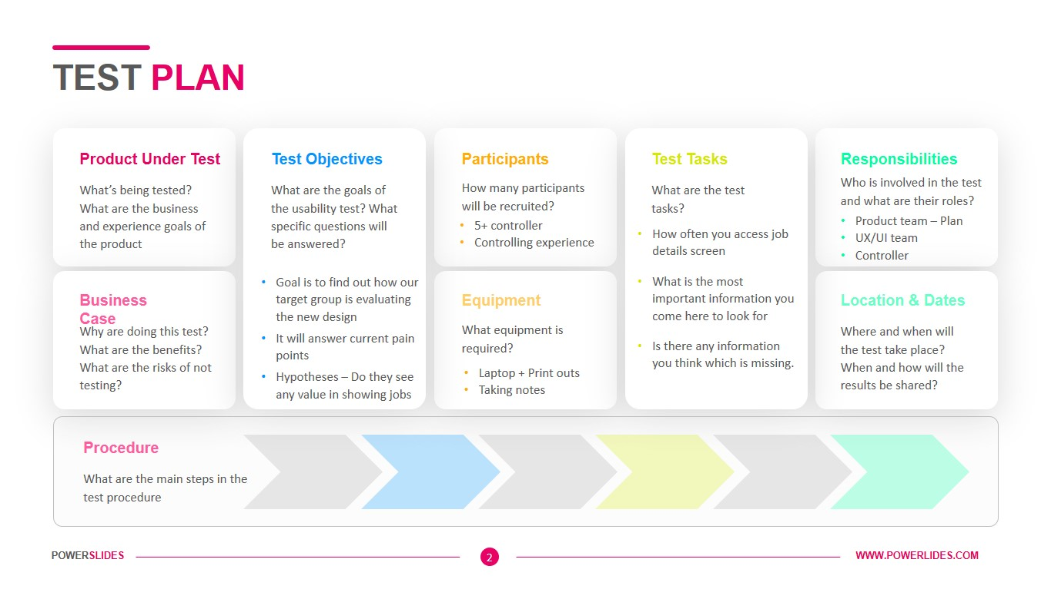
Fundamentals of Software Testing by Bernard Homès , and Bernard Homes, Publisher John Wiley & Sons, Incorporated Date 2012-01-17
Examples of a Test Plan

Slide 23
Overview
Teach
Prove
Id Code Base
Id change in code
Write regression plan with tests
Get copy of code before change
Execute plan
Record results
Write test report
Get copy of code after change
Execute plan again
Record results

Slide 24
Test Plan
Title Page
Section 1: Introduction of Project
Section 2: Requirement
Section 3: Quality Model
Section 4: Test Cases
Section 5: Test Data
Section 6: Test Harness.

Slide 25
Test Plan
Title Page
Test Team name
Project Name
Signature block: with authors names and date
Section 1: Introduction of Project
Provide a description of the project. And the purpose of the Plan
Section 2: Requirement
Create verification requirements based on the workflow from Week 08 Lab.
Create 5 or more requirements from the following summary of the requirements:
User can login into Dr. Mobile, go to the Home Page, add a new Patient, Diagnosis the Patient and Monitor the Patient.
User can order new supplies.
Number each requirement..
Section 3: Quality Model
Identify at least 5 Quality Characteristics.
Use your Prove 5 Quality Models to list the qualities that you identified as part of the system.
For each Quality Characteristic identify at what level (Unit, Regression, Integration) should the test cases be completed.
Section 4: Test Cases
List the Test Cases from assignments Week 08 Lab.
Identify the requirements mapping to the Test Cases
Section 5: Test Data
Identify data that you need to run tests from Test Cases that you worked on in Week 08.
Section 6: Test Harness.
o Identify and list the software that you need to run the automated tests or any additional items you need to run tests for manual, analysis, demo, or inspection tests cases (Prove 08)
Appendix A: Lesson Learned
Provide a summary of lessons that you have learned about testing so far in this class.

Slide 26
Section 2: Requirement
From the Lab this week & last week write requirements
User can login into Dr. Mobile, go to the Home Page, add a new Patient, Diagnosis the Patient and Monitor the Patient.
User can order new supplies.
Create verification requirements based on the workflow from Week 08 Lab.
Create 5 or more requirements from the following summary of the requirements:
User can login into Dr. Mobile, go to the Home Page, add a new Patient, Diagnosis the Patient and Monitor the Patient.
User can order new supplies.
Number each requirement..

Slide 27
Prove: Implement the Plan & Report
Implement your regression test plan and report on the results.
With your partner(s), implement your regression test plan. This includes the following activities:
Pre-Test: Conduct all the test cases and report on the results. Hopefully, each test will pass.
Code Change: Make the planned change to the code. Note that this must be done after the pre-tests are run.
Post-Test: Conduct all the test cases again. Hopefully, all the tests will pass this time too.
Manual or Automated

Slide 28
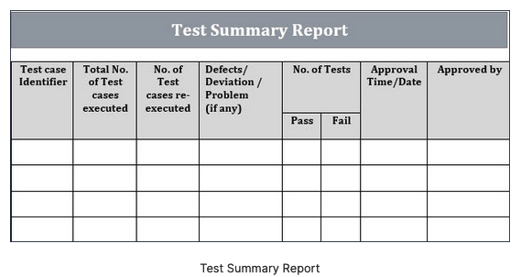
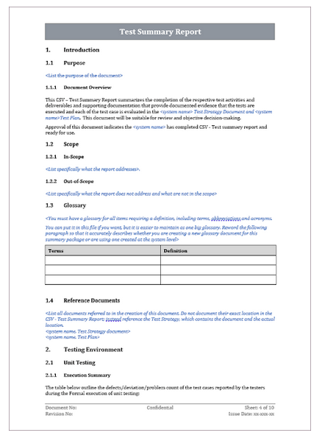
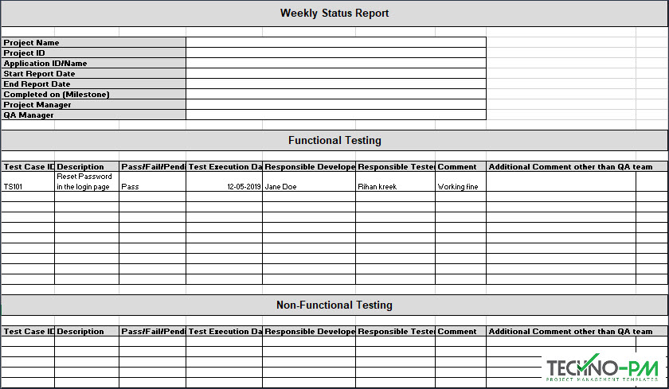
What does a test Report look like?
Simple summary vs Detail
Basics
Purpose: What feature/quality is this testing?
List of Requirements: Uniquely id requirements
List of Test Cases
Mapping of Requirements to Test Cases
Results of Running Test Cases
Number time test was officially run?
Did the tests pass or fail?
Identify any issues that occurred?
Date and Time of execution of test?
Who ran the test case? Witnesses?
Summary of Results: Did the tests satisfy the purpose
Approved?

Slide 29
Overview
Teach
Prove
Id Code Base
Id change in code
Write regression plan with tests
Get copy of code before change
Execute plan
Record results
Write test report
Get copy of code after change
Execute plan again
Record results

Slide 30
Prove: Implement the Plan & Report
Generate a report recording all that transpired. This report must include details of the code change and the result of the test results.
Code Changes
Present the code before the change and after the change. In both cases, only present the code that was changed; do not just insert the entire code-base.
For example, if I were to change a tic-tac-toe board from being a 3x3 array of characters to a 3x3 array of integers, I would include the following:
The before and after of the board declaration.
Any code necessary to convert from a character (in the file format) to an integer (for the new data structure).
Every instance in the code that referenced the board (both before and after the change was made).
Note: if your code change has far-reaching implications (such as the tic-tac-toe board which may be referenced a dozen times), then the number of test cases may be large. In other words, choose your code change carefully!

Slide 31
Prove: Implement the Plan & Report
Test Cases
The report will consist of one section per test case. Each section will consist of the following:
The test case details. In most cases, this will be straight from the plan submitted earlier in the week. However, if a change in the test case is made, then the updated test case will be presented here.
The pre-test results.
The post-test results.
Submission
Your team will submit a single document for your test cases. The document needs to be in the PDF format.
Report Outline
Purpose: What feature/quality is this testing?
List of Requirements: Uniquely id requirements
List of Test Cases
Mapping of Requirements to Test Cases
Code Changes
Results of Running Test Cases
Pre-Test
Date and Time of execution of test?
Who ran the test case? Witnesses?
Post-Test
Summary of Results: Did the tests satisfy the purpose

Slide 32
Overview of reading

Slide 33
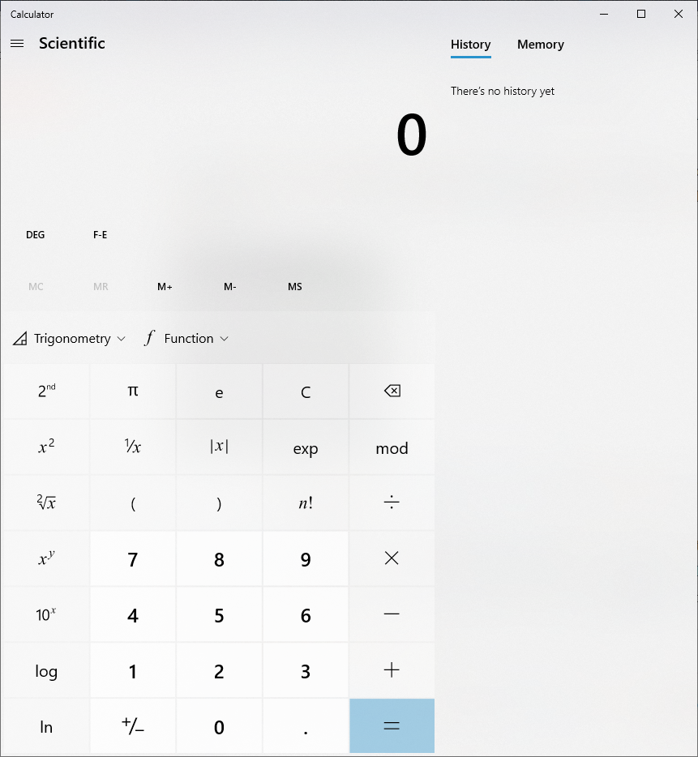
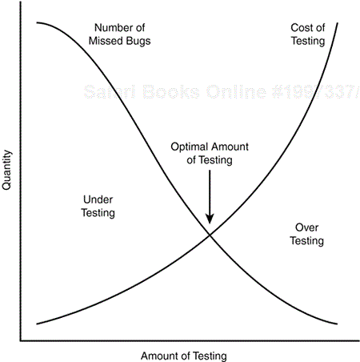
Software Testing, Second Edition
Chapter 3. The Realities of Software Testing
It's Impossible to Test a Program Completely
The number of possible inputs is very large.
The number of possible outputs is very large.
The number of paths through the software is very large.
The software specification is subjective. You might say that a bug is in the eye of the beholder
Software Testing Is a Risk-Based Exercise
Testing Can't Show That Bugs Don't Exist
The More Bugs You Find, the More Bugs There Are
The Pesticide Paradox
The more testing more immune. What about new areas not tested

Slide 34
Software Testing, Second Edition
Chapter 3. The Realities of Software Testing
Not All the Bugs You Find Will Be Fixed
There's not enough time.
It's really not a bug.
It's too risky to fix.
It's just not worth it.
When a Bug Is Difficult to Say
The software doesn't do something that the product specification says it should do.
The software does something that the product specification says it shouldn't do.
The software does something that the product specification doesn't mention.
The software doesn't do something that the product specification doesn't mention but should.
The software is difficult to understand, hard to use, slow, or—in the software tester's eyes—will be viewed by the end user as just plain not right.
Product Specifications Are Never Final
Software Testers Aren't the Most Popular Members of a Project Team
Software Testing Is a Disciplined Technical Profession

Slide 35
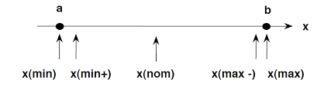
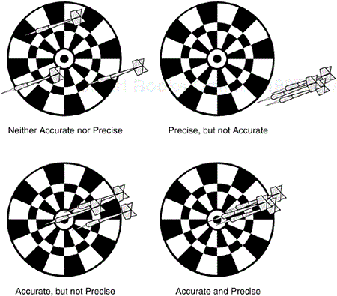
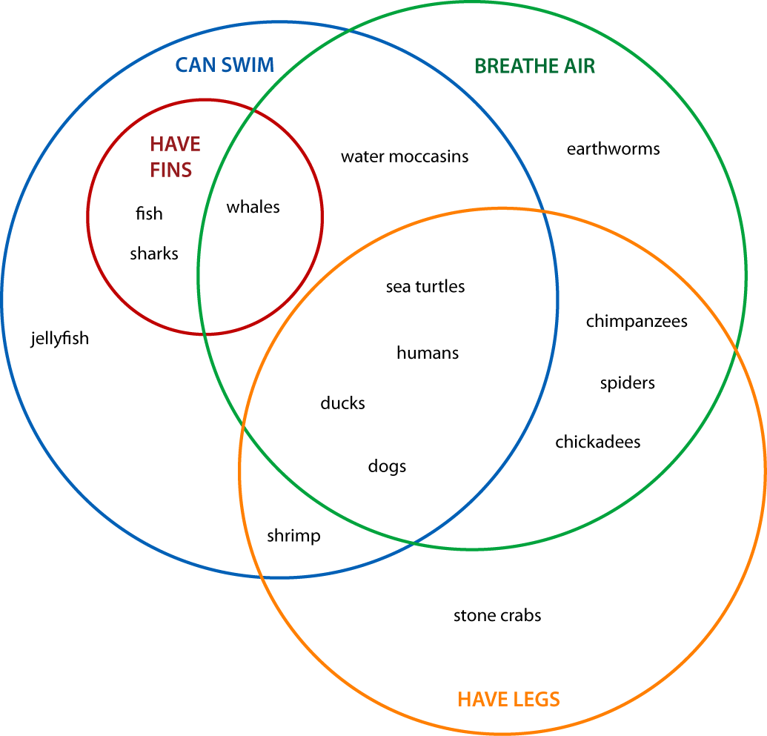
Software Testing, Second Edition
Precision and Accuracy – floating point
Verification and Validation
Quality and Reliability
Testing and Quality Assurance (QA)

Slide 36
Software Testing, Second Edition
Chapter 5. Testing the Software with Blinders On
Dynamic Black-Box Testing: Testing the Software While Blindfolded
Test-to-Pass(happy path) and Test-to-Fail (force error messages)
Equivalence Partitioning
Data Testing (two parts: the data (or its domain) and the program)
Boundary Conditions
Types of Boundary Conditions (Number,
Testing the Boundary Edges (0, 1, *, + <>)

Slide 37
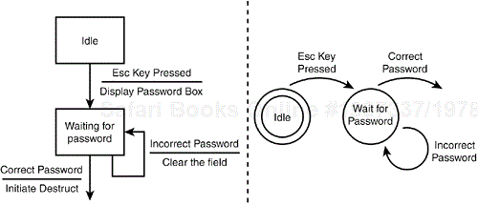
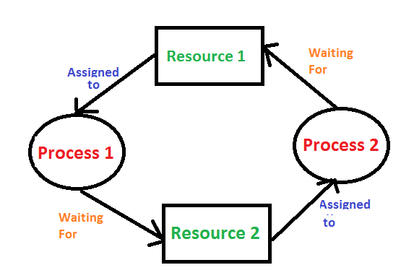
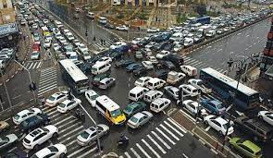
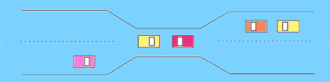
Software Testing, Second Edition
Data Testing
Types: (0,1,*,+/-,^, !, =, <>),
Can of Nothing(Default, Empty, Blank, Null, Zero, and None)
Powers-of-Two (2^x), ASCII/UNICODE,
Invalid, Wrong, Incorrect, and Garbage Data
State Testing
Logic Flow – Workflow
State Transition Map
Each unique state that the software can be in.
The input or condition that takes it from one state to the next.
Set conditions and produced output when a state is entered or exited.
Reducing the Number of States and Transitions to Test
Testing States to Fail
Race Conditions and Bad Timing (Deadlock, Excel open file while field is being edited)
Repetition, Stress, and Load
Other Black-Box Test Techniques
Behave Like a Dumb User
Look for Bugs Where You've Already Found Them
Think like a Hacker
Follow Experience, Intuition, and Hunches

Slide 38
Boundary Edges (0, 1, *, +/-, ^, !, = <>)
Zero, One, Many test (01*)– This type of test checks if the inputs are accepting normal values.
Zero(0) represent nothing. Nothing is different depending on the desired input(int =0, float=0.0, char=’ ‘ or ‘\t’ or ‘\n’ or 0, string=”” empty string or any single char white space).
1- One represents the first nominal test, i.e. 1, 2, 3, …n values that should be expected.
Many(*-regular expression wild card) tests how the program handles multiple types or multiple values.
+/- Plus or minus one – boundary
Power of 2s - (2^x), ASCII/UNICODE
Not the data: Invalid, Incorrect, garabage
Thresholds – above and below margin of error
Boundary Testing (<>) – This type of test checks where the inputs fail, usually providing different type data, length boundaries, invalid values, etc. The program should be able to handle this.

